Slide 1
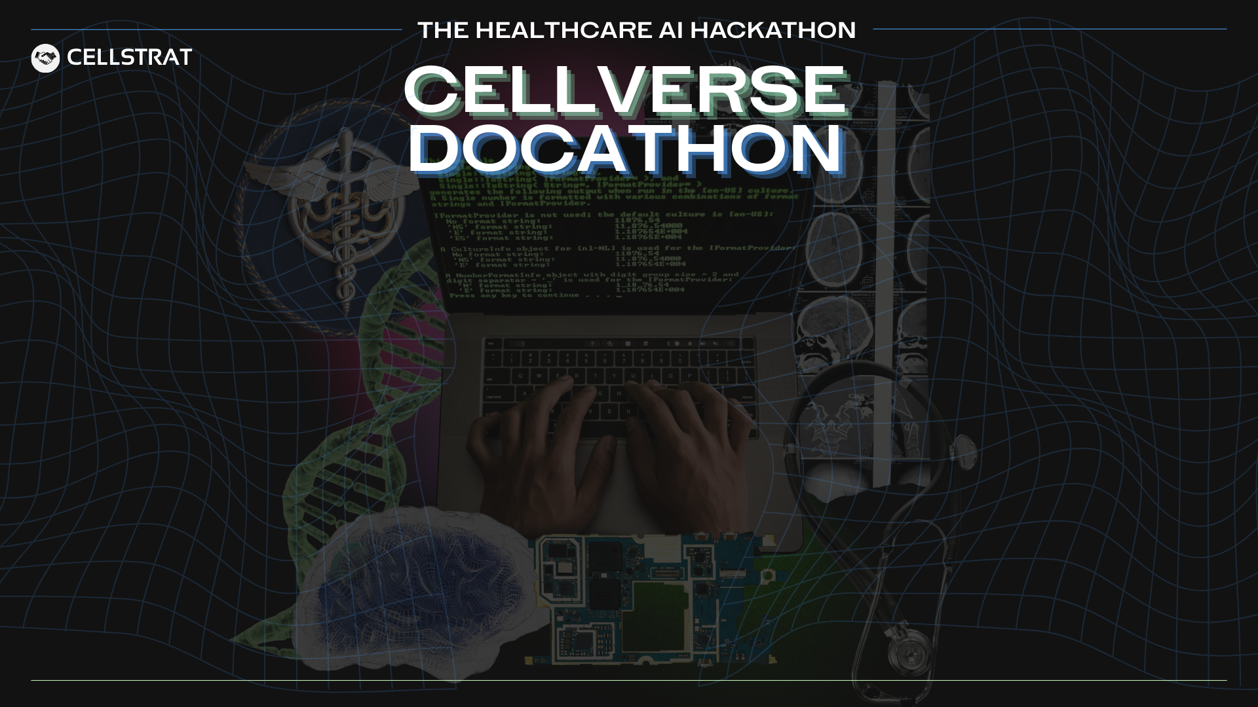
MedEngineers & Team No: 15
Team Details
Engg Team Member 1 (Leader):
Zainab Mahboob Shaik
Organization Name: The Oxford College Of Engineering
Engg Team Member 2:
Preethi A R
Email Id (Team Leader):
zainabshaik862@gmail.com
Contact Number (Team Leader):
Spandana M B
9141610391
Engg Team Member 3:
Engg Team Member 4:
Shoaib Ahmed
Medical Team Member :
Dr Tejasvi Chikkalingaiah
Organization Name: Kempegowda Institute of Medical Sciences
Email Id (Team Leader):
kctejasvi@gmail.com

Slide 2

Problem Statement
What is the challenge you're solving?
Complex GI consultations, rising obesity cases, doctor time loss, and high medico-legal risks due to non-standardized documentation.
Why is the problem important?
Digestive diseases are growing at 8–10% annually, with 2M+ endoscopies yearly. Urban obesity prevalence is 29–35%, and clinical AI is growing at 35% CAGR, highlighting the need for specialized automation.
Who is affected and how?
Gastroenterologists and obesity specialists lose 2–4 hours daily on documentation. Patients face inconsistent care due to unstandardized notes. Clinics risk medico-legal issues.
Any data, numbers, or real-world context you can share?
→ Endoscopy volume: 2M+ annually (2024–25).
→ Bariatric surgery growth: 16–18% CAGR.
→ 300–400 standalone GI clinics and 150–200 obesity clinics in India

Slide 3
Proposed Solution
What solution are you building?
An AI Scribe for GI and obesity clinics that automates consultation notes, endoscopy reports, obesity screening, and consent forms, saving doctor time and improving care.
What technology stack are you using?
Whisper, GPT-4 Turbo, ClinicalBERT, Pegasus Medical, FastAPI..
→ Speech Recognition: Whisper (Still Under-Prepration)
→ NLP Structuring: GPT-4 Turbo / ClinicalBERT
→ Summarization: Pegasus Medical
→ Interfaces: ReactJS
→ Backend: FastAPI

Slide 4
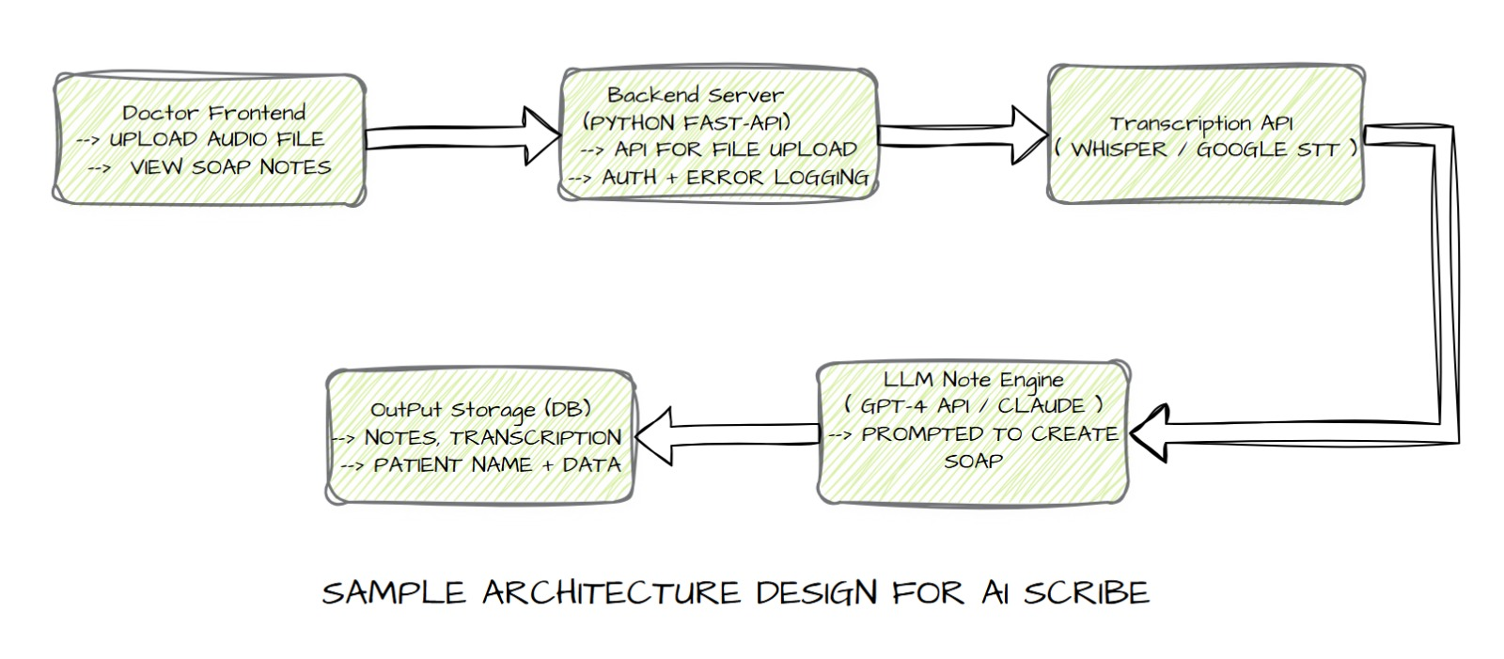
Proposed Solution
Add a visual: solution architecture, workflow sketch, etc.
Any datasets or resources you are using?
→ Medical vocabulary datasets for GI and obesity (e.g., Clinical BERT-trained corpora).
→ HIPAA/GDPR-compliant AWS cloud for data storage.
→ Publicly available endoscopy report templates and obesity screening guidelines.

Slide 5
Impact & Readiness
What real-world impact could this solution create?
Save 25,000+ doctor hours annually, improve care for 1,00,000+ patients, and standardize documentation for 150 GI and obesity clinics by 2028.
Any cost savings, efficiency gains, or improved outcomes?
Saves 2–4 hours/day per doctor. Revenue potential upto: ₹3–5 lakh monthly from 40–50 clinics . Reduces medico-legal risks via compliant notes.
Is your prototype ready?
Yes
Will you be able to demo or present it on May 18?
Yes

Slide 6
Project Implementation Plan
What’s the plan for the week?
→ Day 1–2: Set up the basics. Get Whisper running to capture voice from GI consults.
→ Day 3–4: Add GPT-4 Turbo or ClinicalBERT to turn voice into SOAP notes.
→ Day 5: Sketch out encryption for HIPAA/GDPR (just the plan). Build a quick UI with ReactJS or Flutter to show it off.
→ Day 6: Test everything. Fix bugs so it runs smooth.
→ Day 7: Get ready for the demo and push code to GitHub.
Core functionalities to be developed:
→ Voice capture for consultations/procedures.
→ NLP-structured SOAP notes and endoscopy reports.
→ Obesity screening and consent form automation.
→ HIPAA/GDPR-compliant data encryption.
PROVIDE GITHUB LINK HERE (CODE): https://github.com/shoaibahmed2755/Docathon/tree/main/Main-Project-Folder

